Slide 1
NAT & PAT
Course Code: CSC 3116
Course Title: Computer Networks
Dept. of Computer Science
Faculty of Science and Technology
Lecturer No: | Lab 11 | Week No: | 11 | Semester: | Summer 19-20
Lecturer: | Md. Sakir Hossain, Email: sakir.Hossain@aiub.edu

Slide 2
Lecture Outline
Static NAT
Dynamic NAT
PAT

Slide 3
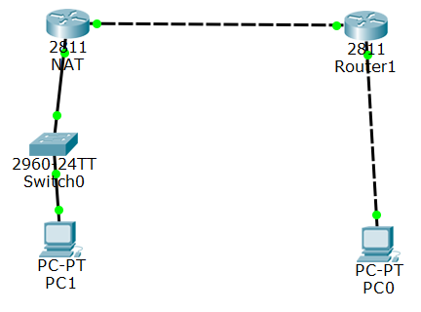
Static NAT
Configuration
Net: 195.5.2.0/24
Configure the routers and PCs as usual
Perform routing
195.5.2.1
0002.1639.B802
195.5.2.2
0030.F22D.9502
192.168.1.254
0002.1639.B801
NAT(config)#int fa0/0
NAT(config-if)#ip nat inside
NAT(config)#int fa0/1
NAT(config-if)#ip nat outside
192.168.1.1
0009.7C45.2C4E
192.16.2.1
NAT(config)#ip nat inside source
static 192.168.1.1 195.15.2.3
Net: 192.168.1.0/24
Net: 192.16.2.0/24
To be replaced
Replaced by

Slide 4
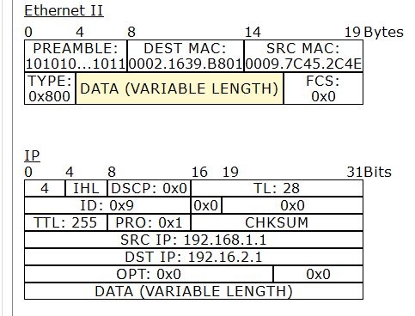
Static NAT
Frames and Packets
Net: 195.5.2.0/24
Incoming PDUs at NAT
195.5.2.1
0002.1639.B802
195.5.2.2
0030.F22D.9502
192.168.1.254
0002.1639.B801
192.168.1.1
0009.7C45.2C4E
192.16.2.1
Net: 192.168.1.0/24
Net: 192.16.2.0/24

Slide 5
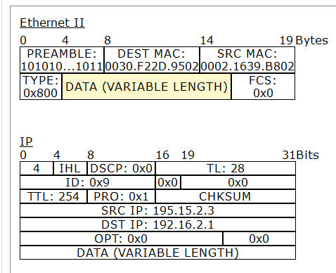
Static NAT
Frames and Packets
Net: 195.5.2.0/24
Outgoing PDUs at NAT
195.5.2.1
0002.1639.B802
195.5.2.2
0030.F22D.9502
192.168.1.254
0002.1639.B801
192.168.1.1
0009.7C45.2C4E
192.16.2.1
Net: 192.168.1.0/24
Net: 192.16.2.0/24

Slide 6
Dynamic NAT
Configuration
NAT(config)#int fa0/0
NAT(config-if)#ip nat inside
NAT(config-if)#int fa0/1
NAT(config-if)#ip nat outside
NAT(config)#ip nat pool mypool 195.15.2.3 195.15.2.100
netmask 255.255.255.0
First IP
Last IP
NAT(config)#access-list 1 permit 192.168.1.0 0.0.0.255
IP in the range 192.168.1.0 to 192.168.1.255 will only be translated
NAT(config)#ip nat inside source list 1 pool mypool

Slide 7
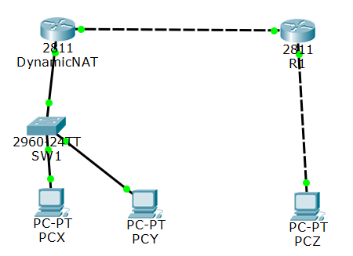
Dynamic NAT….
Sample network for dynamic NAT illustration
Fa0/1
Fa0/0
Fa0/0
Fa0/1
192.168.1.1
192.168.1.2
192.16.2.1

Slide 8
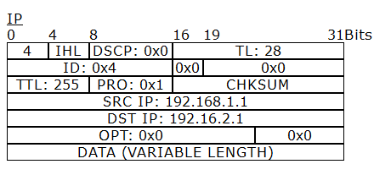
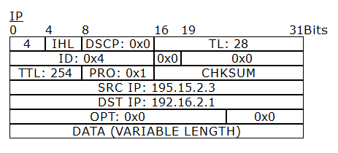
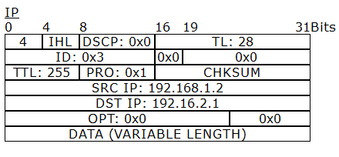

Dynamic NAT….
Sample network for dynamic NAT illustration
(a) Incoming IP header at fa0/0 from PCX
(b) Outgoing IP header at fa0/1 from PCX
(c) Incoming IP header at fa0/0 from PCY
(d) Outgoing IP header at fa0/1 from PCY

Slide 9
PAT
NAT(config)#int fa0/0
NAT(config-if)#ip nat inside
NAT(config-if)#int fa0/1
NAT(config-if)#ip nat outside
NAT(config)#access-list 1 permit 192.168.1.0 0.0.0.255
IP in the range 192.168.1.0 to 192.168.1.255 will only be translated
NAT(config)#ip nat inside source list 1 interface
fastethernet 0/1 overload

Slide 10
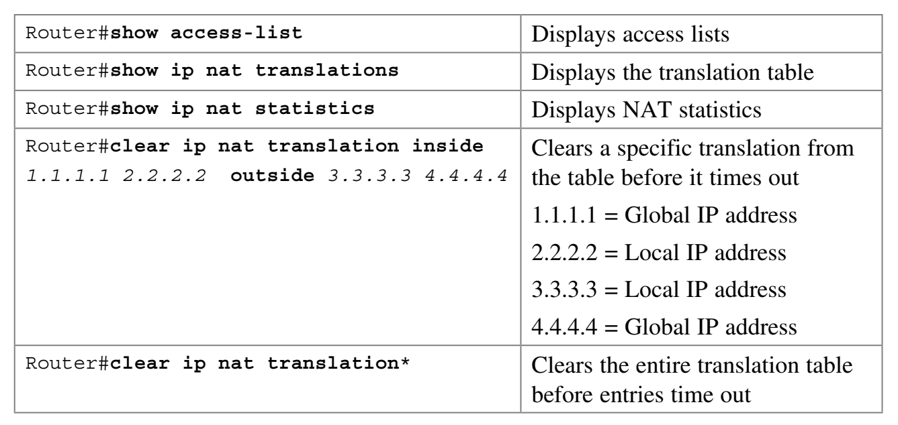
PAT….
Verifying Configurations of NAT and PAT

Slide 11
References
[1] S. Empson, CCNA Portable Command Guide, 2nd ed., Cisco Systems, Inc., 2008, USA.

Slide 12
Recommended Books
Official Cert Guide CCNA 200-301 , vol. 1, W. Odom, Cisco Press, First Edition, 2019, USA.
CCNA Routing and Switching, T. Lammle, John Wily & Sons, Second Edition, 2016, USA.

